Slide 1
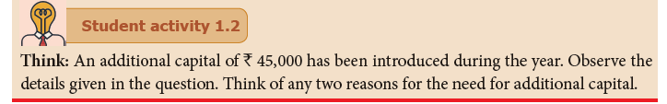

Slide 2
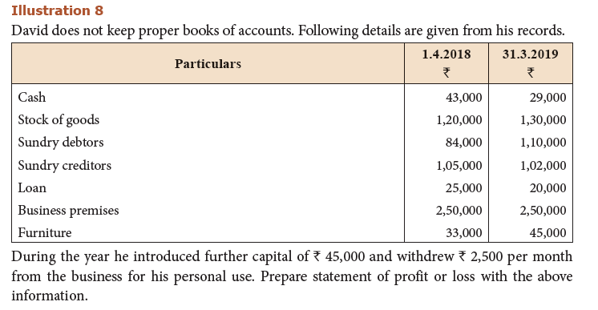

Slide 3
Possible answers could be!
At the end of the year, loan amount has been decreased by ` 5,000.
Value of inventory has been increased by ` 10,000.
Value of furniture has been increased by ` 12,000.
All these mean that, additional capital might have been used for repaying the loan and/or buying inventory and furniture.

Slide 4
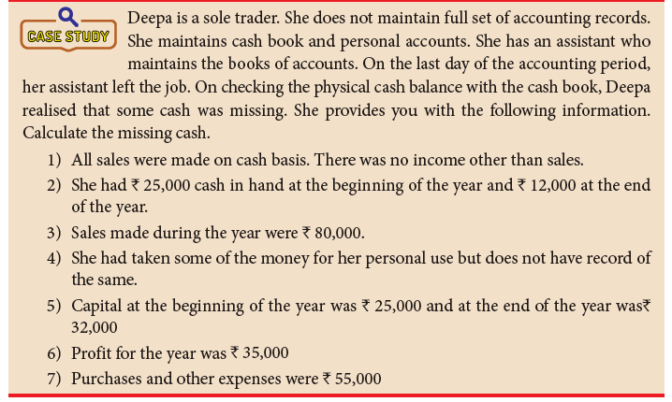

Slide 5
The answer is!
Opening cash balance+ sales – drawings- expenses- closing cash balance = missing cash
` 25,000+ ` 80,000- ` 28,000 - ` 55,000- ` 12,000= ` 10,000
Drawings = opening capital + profit for the year – closing capital
= ` 25,000 + ` 35,000 - ` 32,000
= ` 28,000
Alternatively, cash account can be opened to find out the missing cash and capital account can be opened to find out drawings.

Slide 6
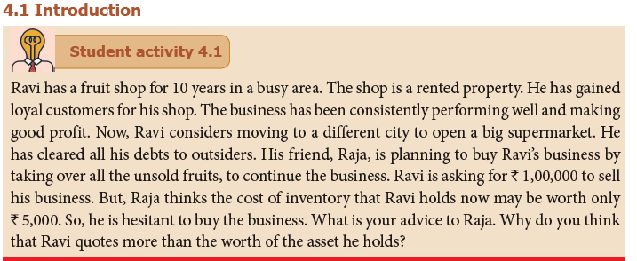

Slide 7
How to conduct this activity?
Just a minute activity may be done.
Ask students, ‘Think of any one successful/profitable shop/brand that you know and in one minute, list down as many reasons as possible , for its success’.
In continuation of this activity, the textbook activity may be discussed.

Slide 8
Possible answers may include!
Ravi has established good location, loyal customers, good quality products and good supplier relationship and hence, his efforts need to be recognised.
A business may be valued not just by its assets, but by its reputation too.
Raja need not spend much time to look for customers, as the business has already gained customer loyalty
Ravi’s future earning capacity may be good, compared to if he starts entirely a new business on his own.
Raja is advised to take over Ravi’s well established, profitable business by paying more than the cost of inventory that Ravi holds.

Slide 9
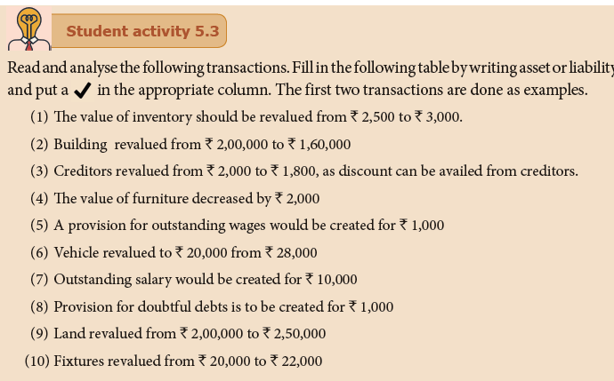

Slide 10
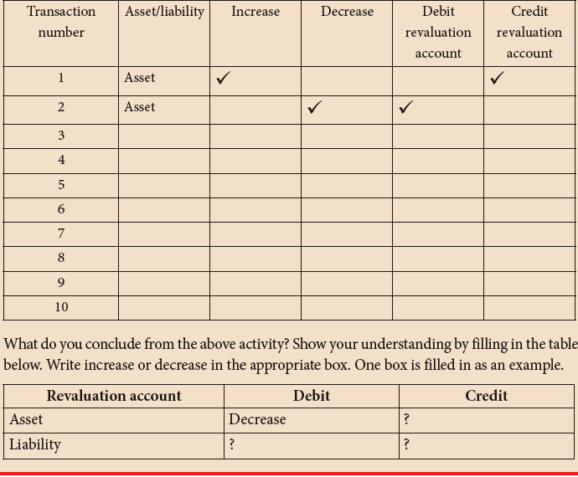

Slide 13
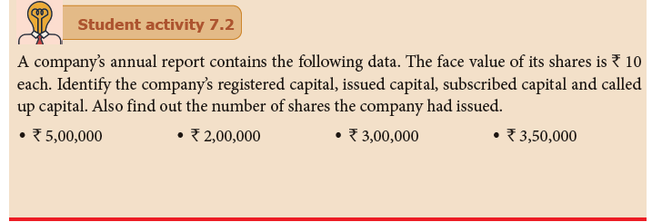

Slide 14
The answer is!
Registered capital is ` 5,00,000
Issued capital is ` 3,50,000
Subscribed capital is ` 3,00,000
Called up capital is ` 2,00,000
The number of shares the company had issued is 35,000.
Pair work: Some more transactions may be used for practice, in the form of Rapid fire.

Slide 15
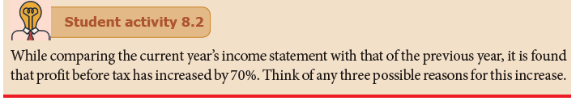

Slide 16
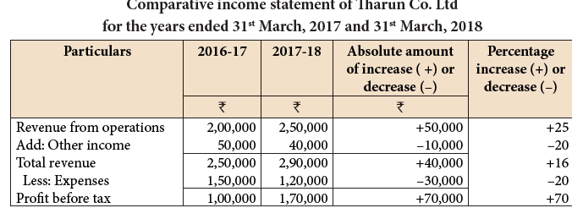

Slide 17
Possible answers could be!
Selling price might have increased that has resulted in increase from revenue from operations.
Buying cheaper supplies might have resulted in decrease in cost of sales [ cost of goods sold]
The business has good control over expenses.
And, any other relevant reasons can be accepted.

Slide 18
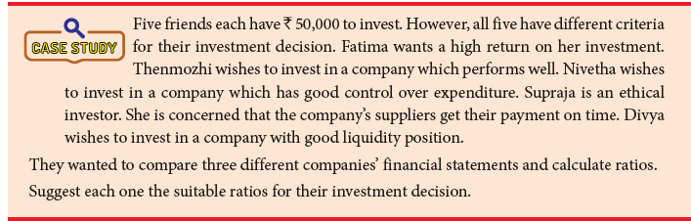

Slide 19
Possible answer could be!
Fatima- Return on Investment
Thenmozhi – Gross profit margin/ Net profit margin/ ROI
Nivetha – Net profit margin
Supraja – Credit payment period
Divya – Current ratio/ Quick ratio

